Slide 1
MODIS NDVI Masks
Compiled February 2, 2012

Slide 2
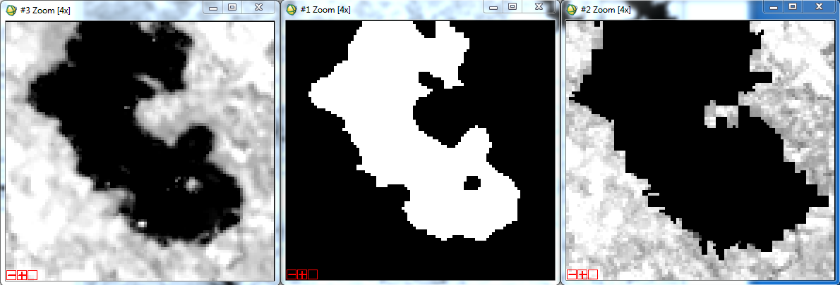
Lake Livingston
Unmasked NDVI MOD44W 250m mask MOD03 1km mask w/ NDVI

Slide 3
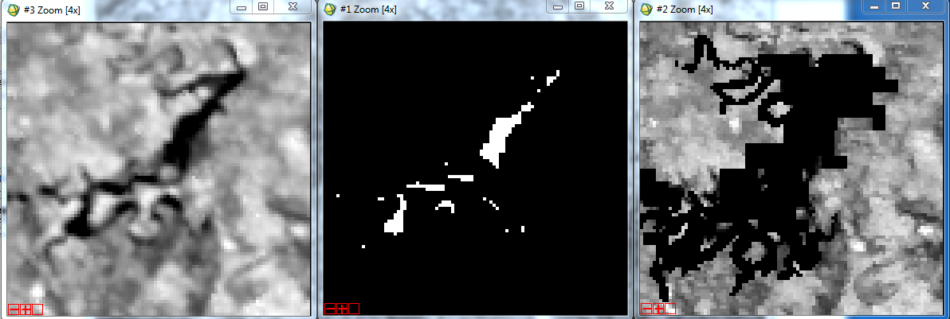
Possum Kingdom
Unmasked NDVI MOD44W 250m mask MOD03 1km mask w/ NDVI

Slide 4
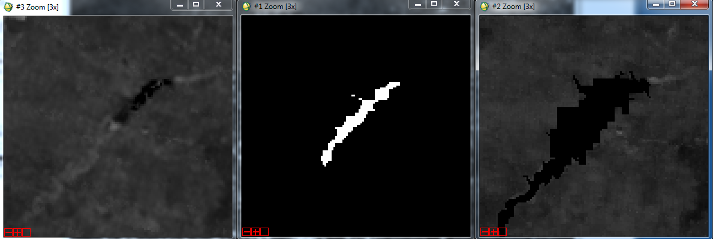
Lake Meredith
Unmasked NDVI MOD44W 250m mask MOD03 1km mask w/ NDVI

Slide 5
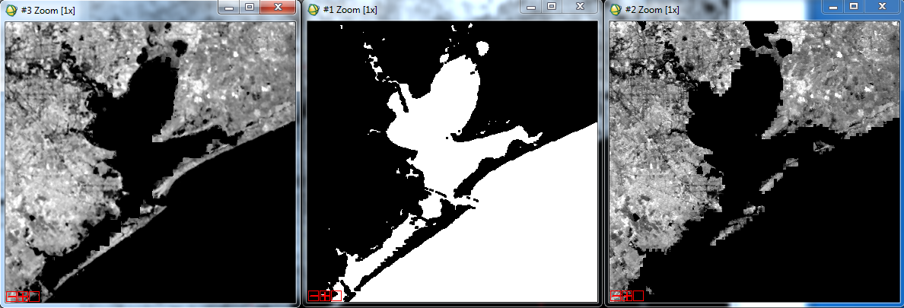
Galveston Bay
Unmasked NDVI MOD44W 250m mask MOD03 1km mask w/ NDVI

Slide 6
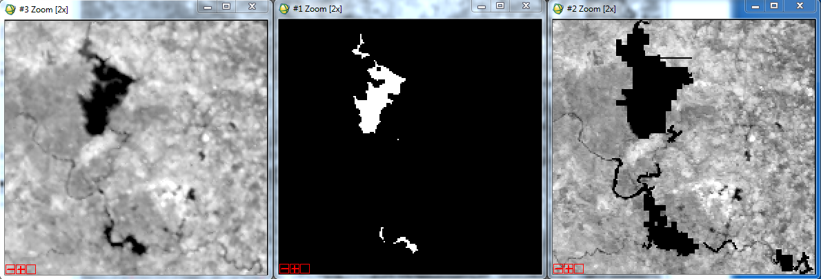
Lakes Buchanan & LBJ (Travis in SE)
Unmasked NDVI MOD44W 250m mask MOD03 1km mask w/ NDVI

Slide 7
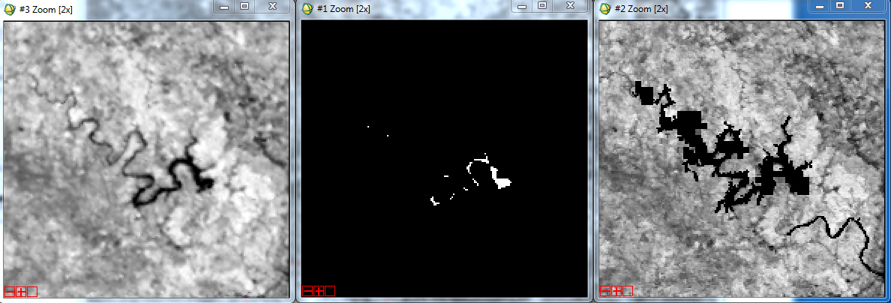
Lake Travis
Unmasked NDVI MOD44W 250m mask MOD03 1km mask w/ NDVI

Slide 8
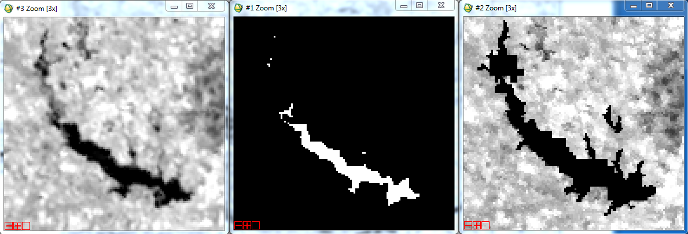
Lake O’ The Pines
Unmasked NDVI MOD44W 250m mask MOD03 1km mask w/ NDVI

Slide 9
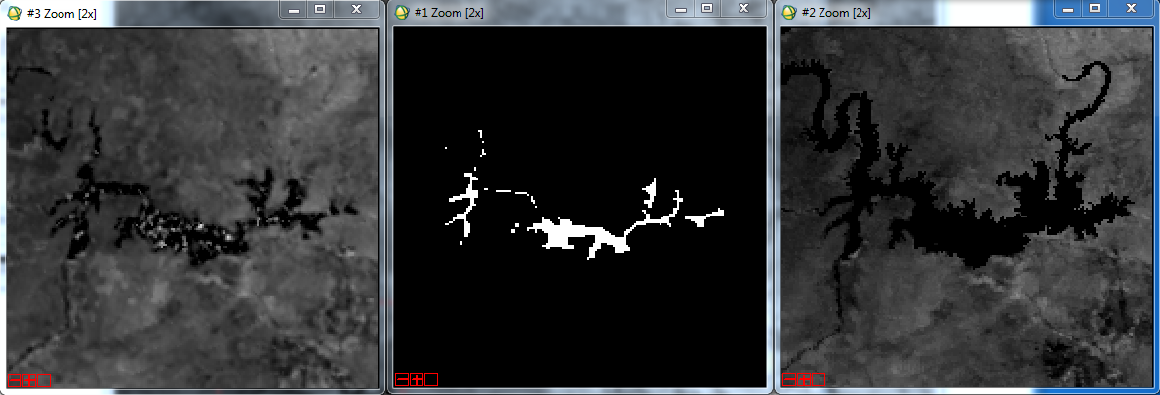
Lake Amistad
Unmasked NDVI MOD44W 250m mask MOD03 1km mask w/ NDVI

Slide 10
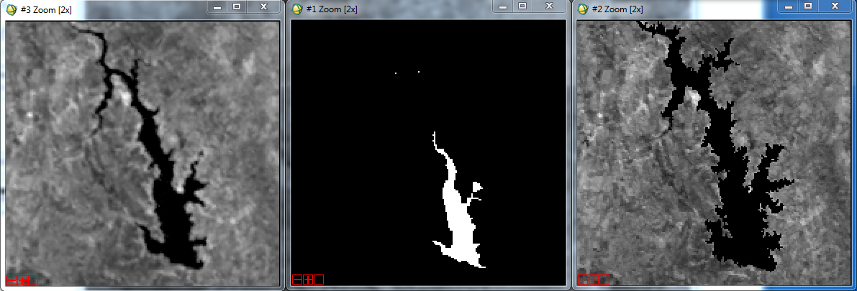
Falcon Reservoir
Unmasked NDVI MOD44W 250m mask MOD03 1km mask w/ NDVI

